Slide 1


Presented by KSR Datavizon
Hackathon! power bi project
Trends and challenges
www.datavizon.com

Slide 2
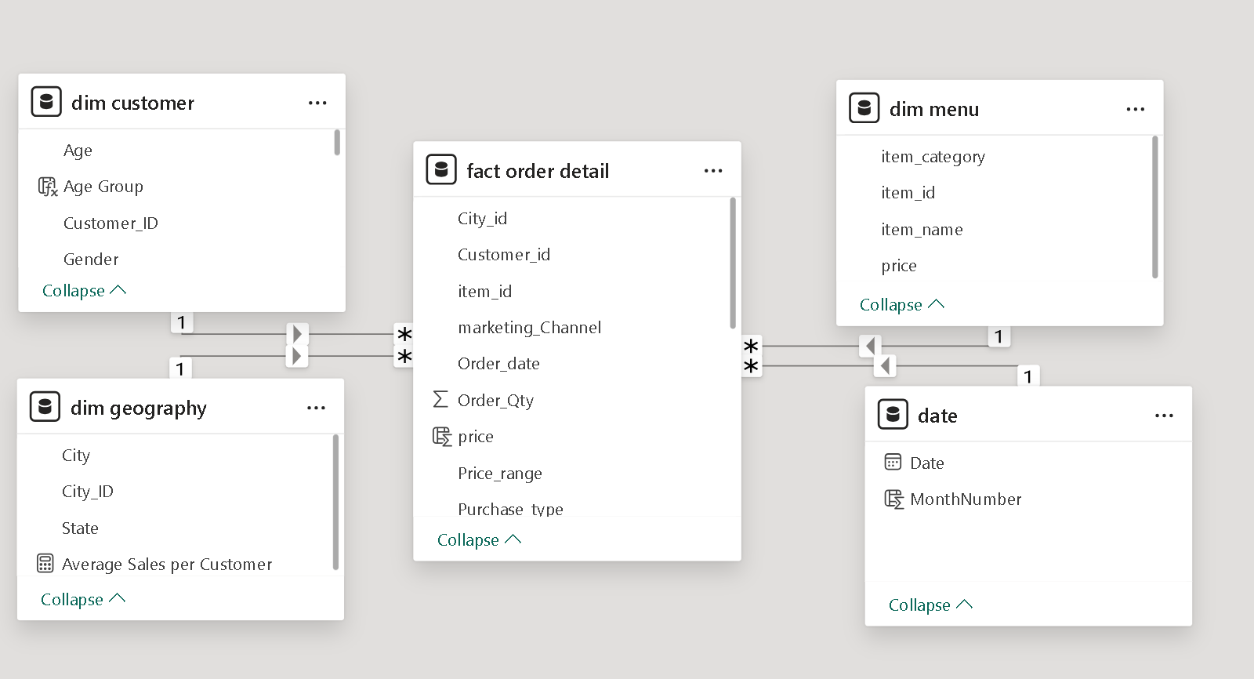
DATA MODEL

Slide 3


Primary Insights

Slide 4
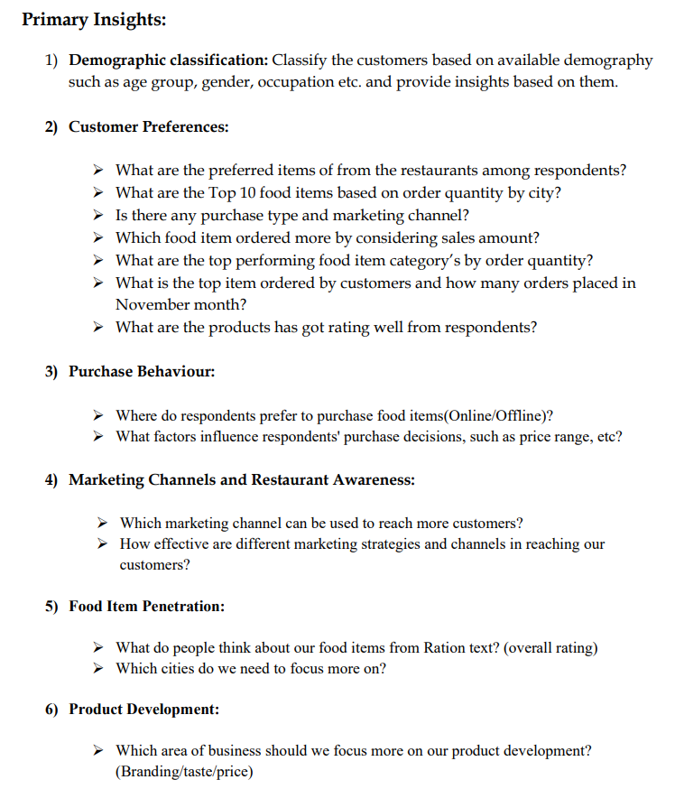

Slide 5

Customer Overview
Customer Overview presents customer demographics, purchase behavior, and preferences, highlighting key segments by age, gender, and repeat purchase patterns to guide targeted marketing strategies.

Slide 6
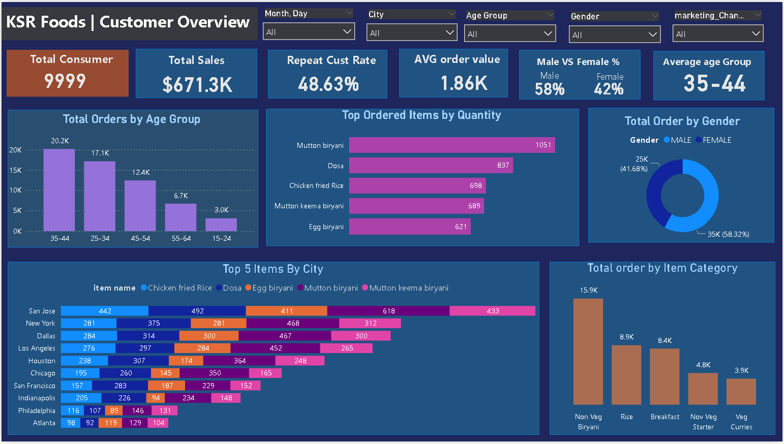

Slide 7

Order Insights & Trends
Order Insights and Trends displays key metrics like total consumers, sales, repeat customer average, and top November items. Visuals include order trends by price range, ratings, purchase types, and item categories, highlighting customer preferences and sales performa

Slide 8
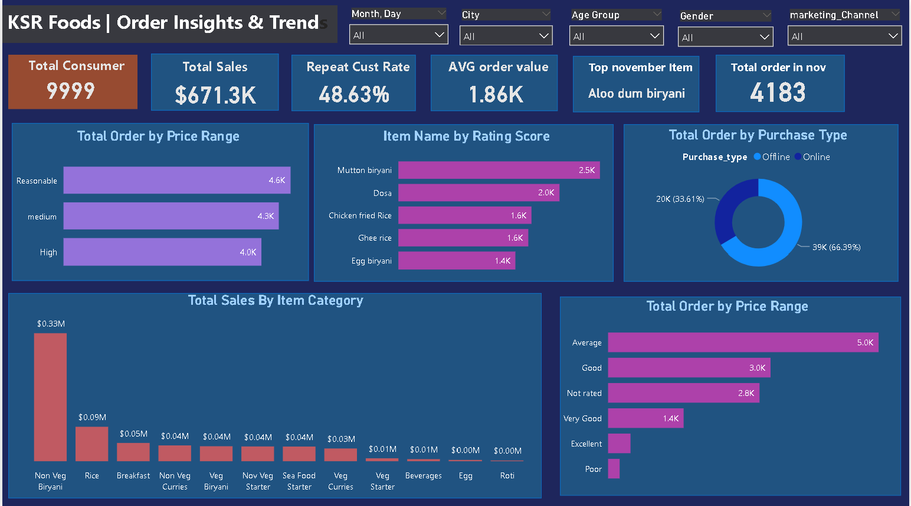

Slide 9
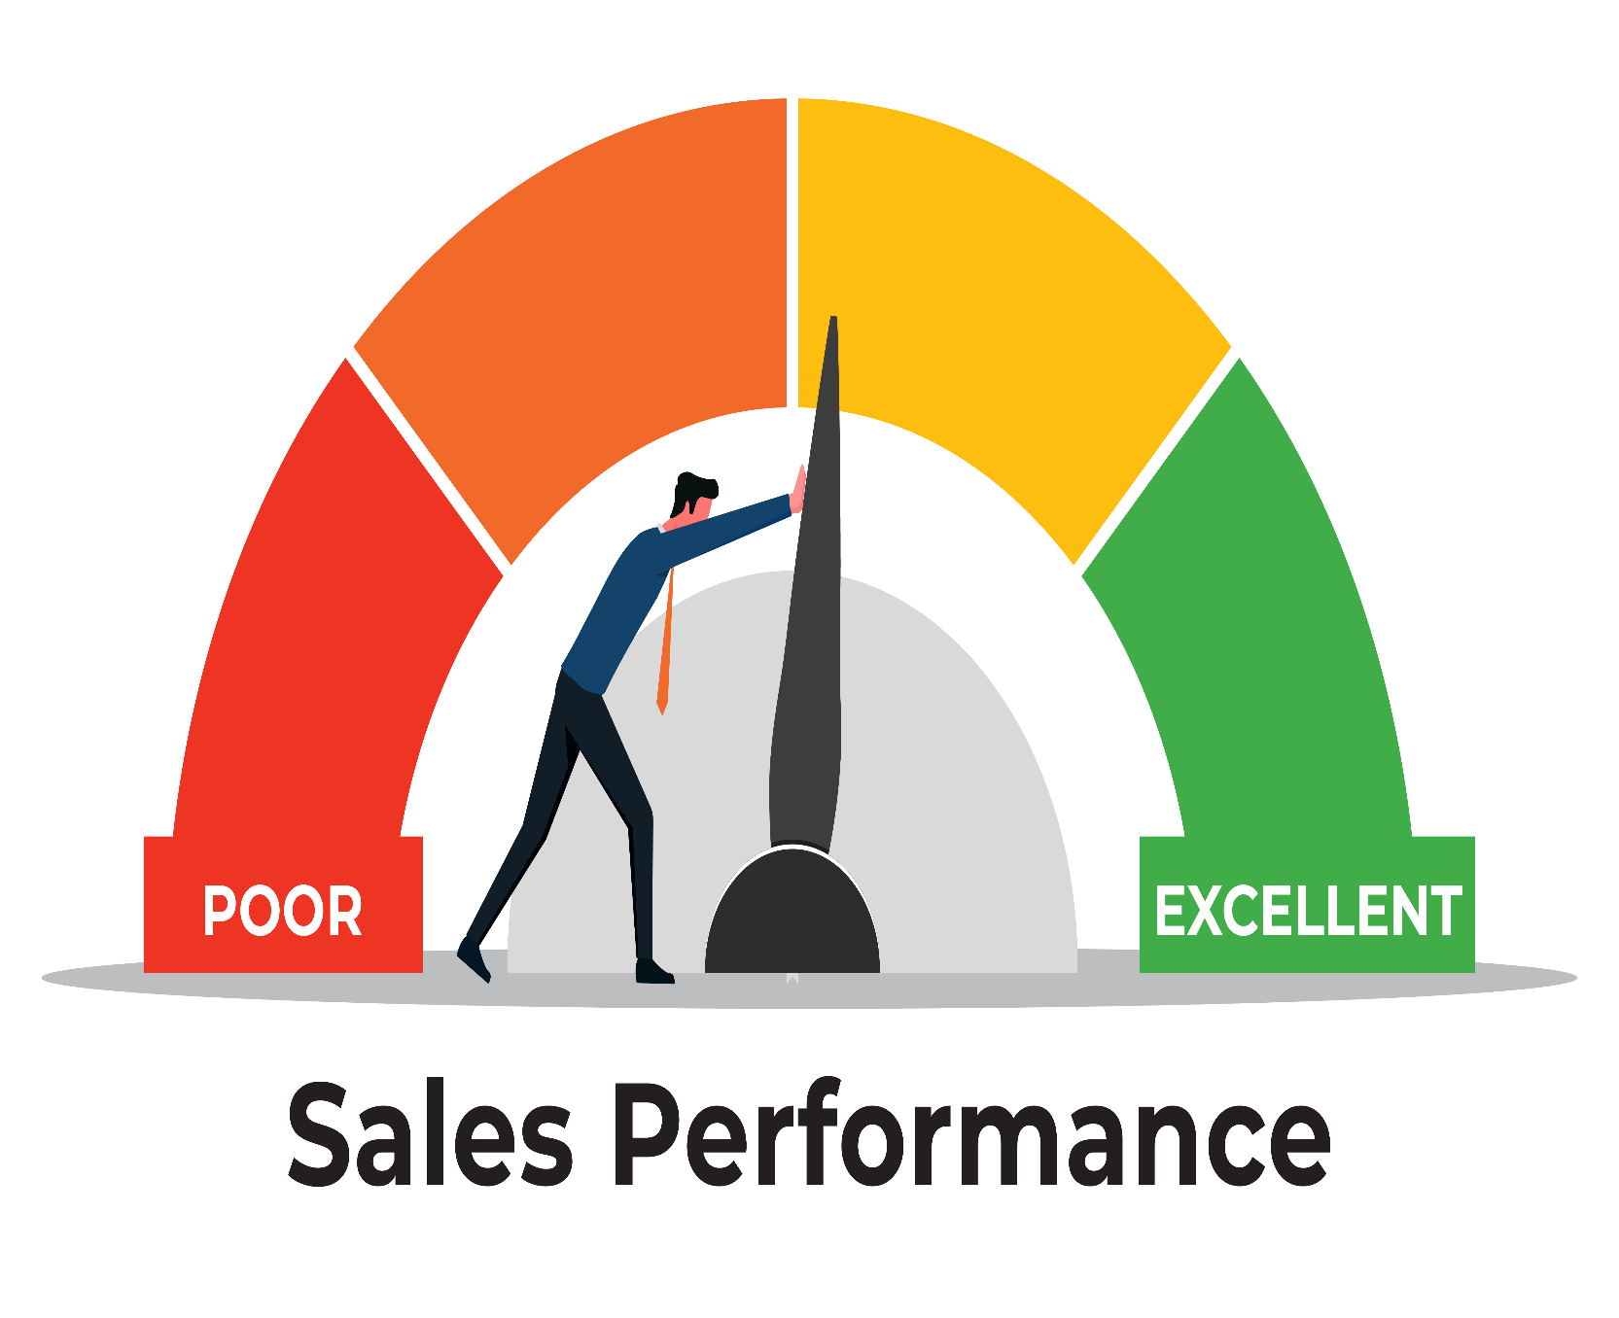
Sales Performance
Sales Performance analyzes top-selling items, categories, and overall sales, showcasing metrics like total sales and average order value. The page features a waterfall chart for monthly sales breakdown and a decomposition tree, diving into sales by category, item, city, and marketing channel to reveal deeper insights into sales drivers

Slide 10
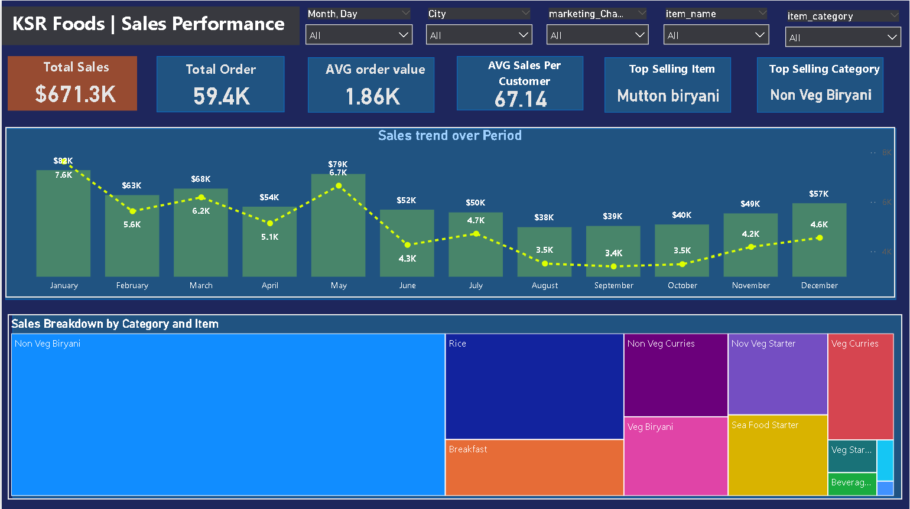

Slide 11
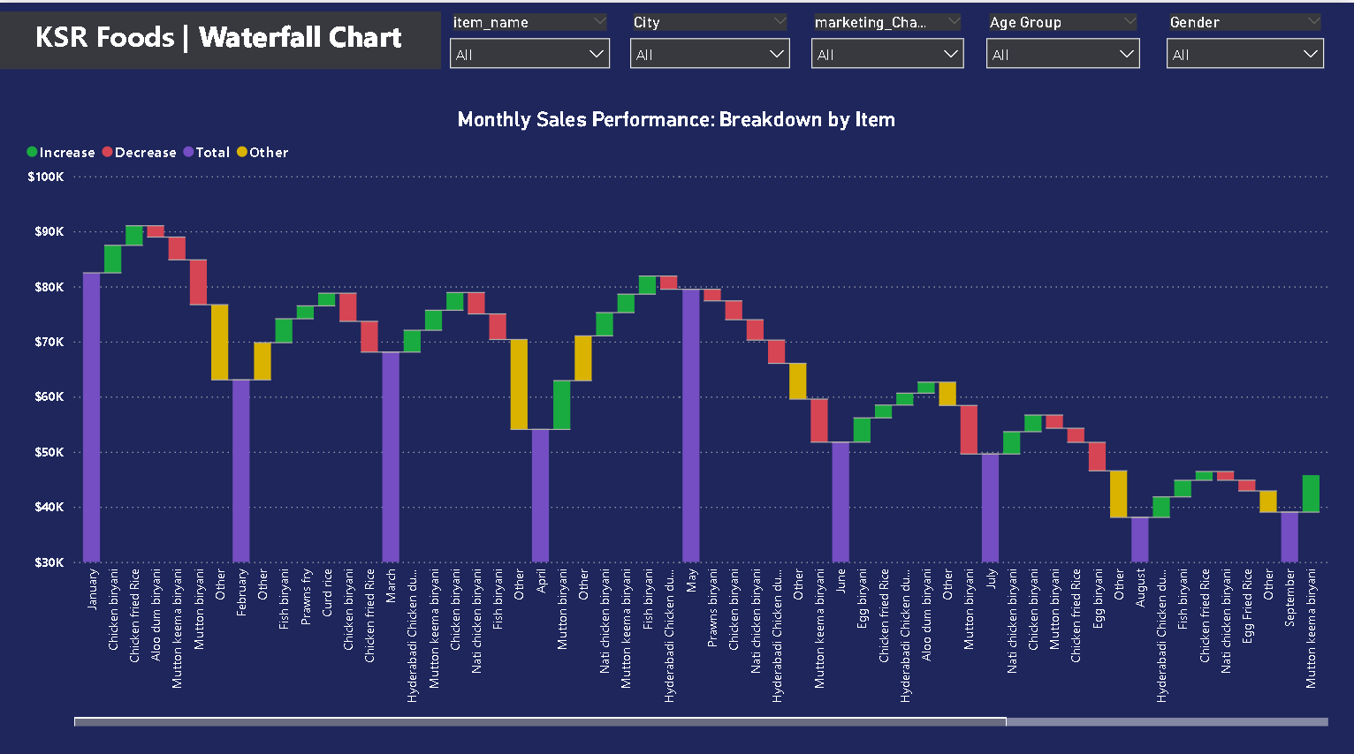

Slide 12
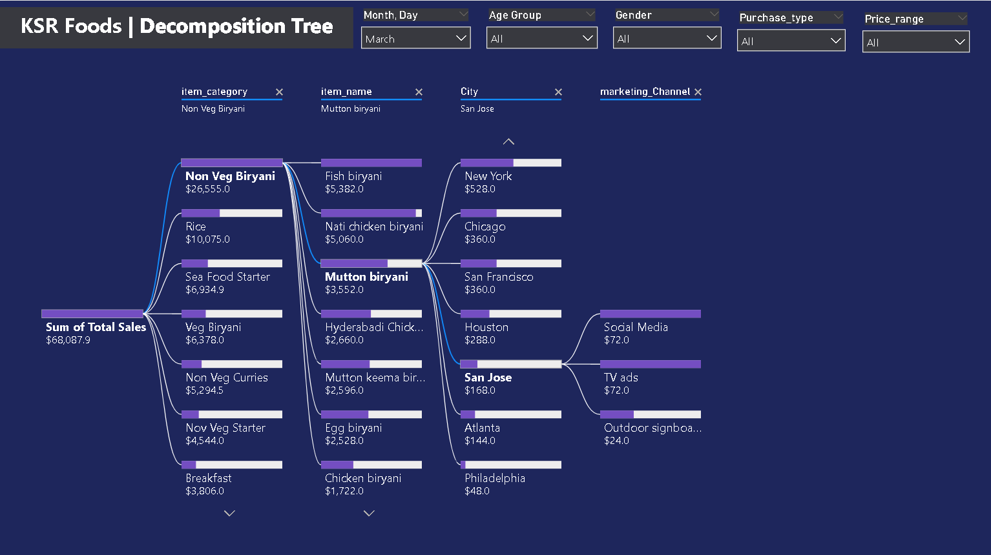

Slide 13
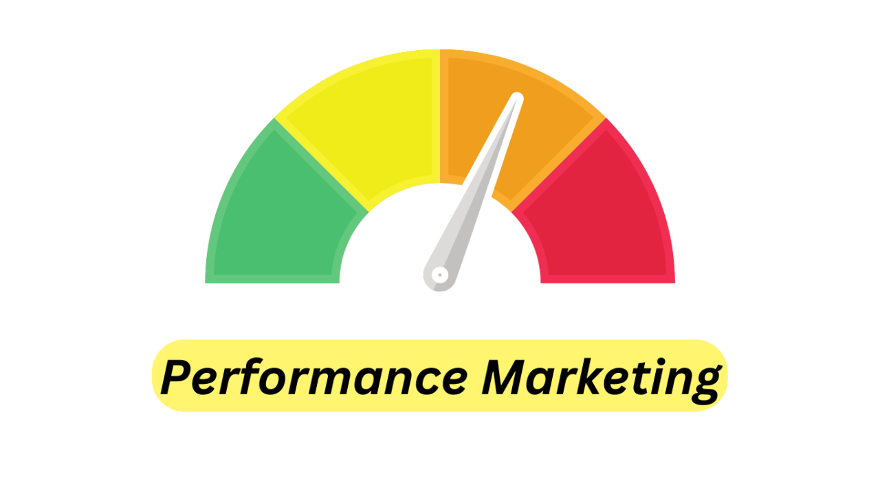
Marketing Effectiveness
Marketing Effectiveness evaluates the impact of marketing channels and purchase types on customer behavior. Key KPIs such as total orders by marketing channel and sales split between online and offline purchases are displayed. Visuals like a donut chart for purchase types and a bar chart for orders by marketing channel provide insights into which strategies are driving customer engagement and sales.

Slide 14
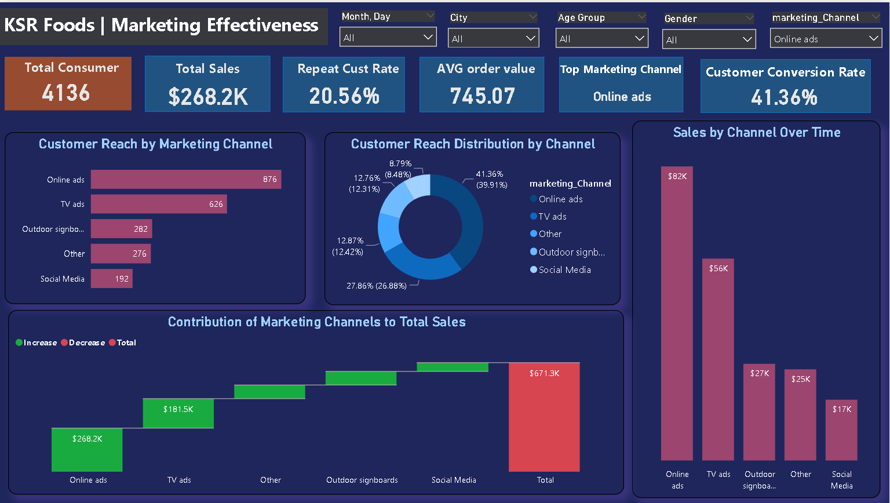

Slide 15
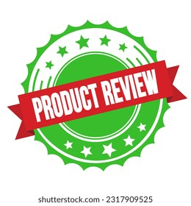
Feedback and Product Development
Feedback and Product Development focuses on analyzing customer ratings and feedback to identify areas for improvement. Key metrics such as average rating, top-rated items, and total reviews are highlighted. Visuals like a clustered bar chart showing item ratings and customer satisfaction trends provide insights to guide product enhancements and refine offerings based on customer preferences.

Slide 16
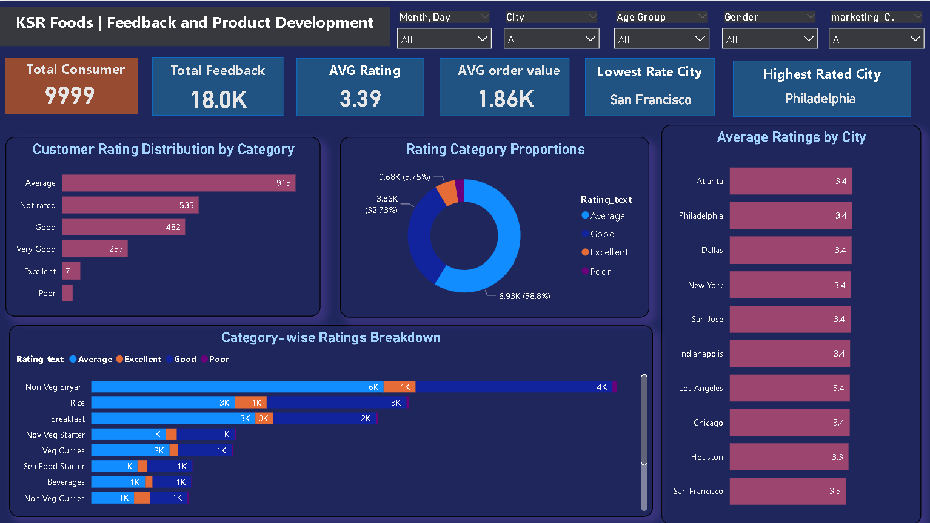

Slide 17
Secondary Insights

Slide 18
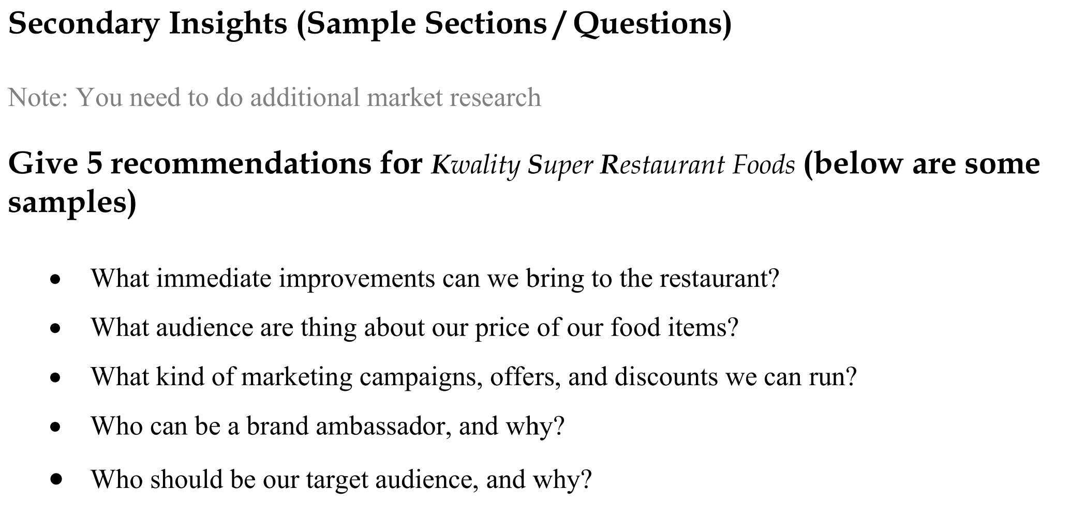

Slide 19
Improvements
Improve Food Quality: Enhance recipes and ingredient quality to raise taste ratings and overall dining experience.
Address San Francisco Issues: Investigate and resolve specific customer complaints in San Francisco to improve local ratings. Revamp Non-Veg Curries: Update recipes and ensure consistency in the non-veg curries category to boost ratings. Optimize Online Ads: Continue investing in and refining online ads to increase reach and sales, using targeted and engaging content. Focus on Age Group 35-44: Create promotions and personalized offers for the 35-44 age group to leverage their high order volume and frequency.

Slide 20
What audience are thing about our price of our food items?
General Perception: The majority of customers find the pricing reasonable or medium, indicating that pricing aligns well with customer expectations for most items. However, there is a substantial portion who still finds the prices high, suggesting some price sensitivity. Impact on Ratings: The low ratings for Egg Roti, Veg Starter, and Veg Biryani might be influenced by their pricing. If these items are priced higher than what customers perceive as reasonable value, it could lead to lower satisfaction and ratings. Addressing the pricing or improving the perceived value of these items could enhance their ratings.

Slide 21
What kind of marketing campaigns, offers, and discounts we can run?
Target Discounts on Low-Rated Items: Offer promotions on low-rated items like Egg Roti and Veg Biryani to boost their appeal and improve ratings.
Leverage Online Ads: Increase investment in online advertising, which has the highest reach and generates significant sales, to attract more customers
Focus on Age Group 35-44: Create targeted promotions and loyalty programs for the 35-44 age group, the most frequent buyers, to enhance their experience and drive repeat business

Slide 22
Who should be our target audience, and why?
Age Group 35-44: This group shows the highest total order volume and frequent purchases. Tailoring marketing strategies to this demographic can leverage their strong buying power.
Online Shoppers: With 41.6% of customers coming through online ads, focusing on digital marketing strategies and online promotions will effectively reach a significant portion of your customer base.
Cities with Low Ratings: Targeting improvement efforts and marketing campaigns in cities like San Francisco, which have lower ratings, can help enhance overall satisfaction and performance in those areas.

Slide 23
Who can be a brand ambassador, and why?
A well-known person can make an excellent brand ambassador, but the decision ultimately depends on your budget. If you have the resources, consider hiring someone with a strong social media following who can influence your target audience. For example, Rana Hamza Saif, a popular YouTuber known for his food vlogs and reviews, could be a great choice for a food-related brand.

Slide 24

Presented by Sandra Haro
Thank you very much!
www.datavizon.com

